Slide 1

Memory and Data Movement
Cong (Callie) Hao
callie.hao@ece.gatech.edu
Assistant Professor
ECE, Georgia Institute of Technology
Sharc-lab @ Georgia Tech https://sharclab.ece.gatech.edu/

Slide 2


Hardware Design with HLS
Where does performance gain come from?
Specialization
Parallelization
Data-type
Arbitrary fixed-point precision, customized floating-point precision
Memory and data movement
Customized data storage in banks
Customized data loading and feeding
Computation
How do you schedule the computations?
Order, granularity, etc.
Operation level parallelism
Multiple operations or instructions executed simultaneously
Mostly about loop manipulation and data partitioning
Task level parallelism (TLP)
Dataflow and streaming
Overlapped compute and data movement

Slide 3
Memory Performance: 3 knobs
Bandwidth: how many bits per cycle you could move
burst, wide bus, vector types
Reuse: how many times you use data after paying to fetch it
local buffers, partitioning
Overlap: whether compute waits for memory
double buffering, streaming, dataflow

Slide 4
Outline
Burst mode
Wide bus transaction
Double Buffer
Streaming
C/RTL Co-simulation

Slide 5
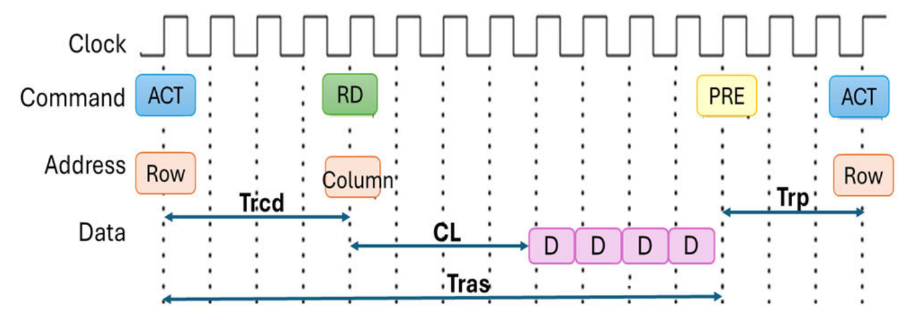
DRAM Data Access
Large overhead (setup time) for each data access from/to DRAM
Co-sim shows 2 cycles (older version shows 16 cycles); on-FPGA can be even larger
Y. Y. Chew et al.: In-Depth Review and Comparative Analysis of DRAM-Based PUFs

Slide 6
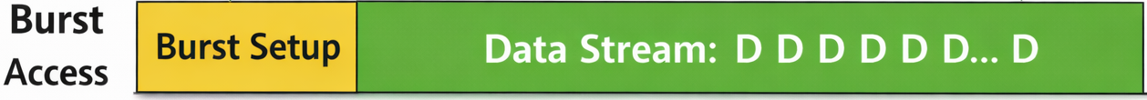
Burst Mode
Setup once, transfer multiple data chunks
The larger burst size, the better

Slide 7
Burst Mode for Continuous Memory Access
Assume it’s 32-bit
void test( FIX_TYPE A[100][100], ...) {
#pragma HLS interface m_axi port=A offset=slave bundle=mem
FIX_TYPE A_local[100][100];
for(int i = 0; i < 100; i++) {
for(int j = 0; j < 100; j++) {
A_local[i][j] = A[i][j];
}
}
...
}
How do you like this design?
What’s its best performance?
32-bit per cycle

Slide 8
Burst Mode for Continuous Memory Access
void test( FIX_TYPE A[100][100], ...) {
#pragma HLS interface m_axi port=A offset=slave bundle=mem
FIX_TYPE A_local[100][100];
for(int i = 0; i < 100; i++) {
for(int j = 0; j < 100; j++) {
A_local[i][j] = A[i][j];
}
}
...
}
Multiple burst reads of length 10000 and bit width 32 in loop xxx has been inferred on port 'mem'
Enable burst mode whenever possible by using continuous memory access

Slide 9

Bad Practice
for(int i = 0; i < 100; i++) {
for(int j = 0; j < 100; j+=2) {
A_local[i][j] = A[i][j];
}
}
> 12000 cycles (expected 5000)
Do not burst because memory is not continuous
for(int j = 0; j < 100; j++) {
for(int i = 0; i < 100; i++) {
A_local[i][j] = A[i][j];
}
}
> 20000 cycles (expected 10000)

Slide 10
Wider Bus Transaction
Assume it’s 32-bit
void test( FIX_TYPE A[100][100], ...) {
#pragma HLS interface m_axi port=A offset=slave bundle=mem
FIX_TYPE A_local[100][100];
for(int i = 0; i < 100; i++) {
for(int j = 0; j < 100; j++) {
A_local[i][j] = A[i][j];
}
}
...
}
32-bit per cycle
Is this good enough?
AXI bus is 512 bit wide – 15/16 bandwidth is wasted!

Slide 11
Outline
Burst mode
Wide bus transaction
Double Buffer
Streaming
C/RTL Co-simulation

Slide 12
Wider Bus Transaction
320-bit customized datatype
32b | 32b | 32b | 32b | 32b | 32b | 32b | 32b | 32b | 32b
32b
...
32b
...
32b
...
32b
...
32b
...
32b
...
32b
...
32b
...
32b
...
32b
...
Partitioned local arrays

Slide 13

Wider Bus Transaction
Create a customized wide data type – 320 bit
typedef ap_uint<320> MEM_TYPE;
void test( MEM_TYPE A[100*10], ...) {
#pragma HLS interface m_axi port=A offset=slave bundle=mem
FIX_TYPE A_local[100*100];
#pragma HLS array_partition variable=A_local cyclic factor=10
for(int i = 0; i < 100*10; i++) {
#pragma HLS pipeline
MEM_TYPE data = A[i];
for(int ii = 0; ii < 10; ii++) {
A_local[i*10 + ii] = data.range(0 + (ii*32), 31 + (ii*32));
}
}}
...
}
Reorganize into 1D array
Read 320 bit at each cycle
[INFO] Multiple burst reads of length 1000 and bit width 512

Slide 14
Use HLS Vector
hls::vector<T, N>: to model and synthesize single instruction multiple data (SIMD) type operations
T: The type of elements in the vector; can be a user-defined type
N: The number of elements that the vector holds
The best performance is achieved when both the bit-width of T and N are integer powers of 2
HLS will reconfigure the BRAM port width to support a vector
typedef hls::vector<int, 8> int8Vec;
int8Vec intVectorA, intVectorB;
void processVecStream(hls::stream<int8Vec> &inVecStream1,
hls::stream<int8Vec> &inVecStream2,
hls::stream<int8Vec> &outVecStream)
{
for(int i=0;i<32;i++) {
#pragma HLS pipeline II=1
t_int8Vec aVec = inVecStream1.read();
t_int8Vec bVec = inVecStream2.read();
t_int8Vec cVec = aVec * bVec;
outVecStream.write(cVec);
}
}
aVec
int | int | int | int | int | int | int | int
bVec
int | int | int | int | int | int | int | int

Slide 15
Outline
Burst mode
Wide bus transaction
Double Buffer
Streaming
C/RTL Co-simulation

Slide 16




Single Buffer Limitation
Read-Execute-Write create dependency
Load
PE
Execution
PE
Store
PE
buf1
buf2
Input Buffer
(BRAM)
Output Buffer
(BRAM)
DRAM
DRAM
*PE: processing element

Slide 17
Single Buffer Limitation
Read-Execute-Write create dependency
buf1
buf2
Cannot execute on buf1 if the load function is unfinished
Load

Slide 18
Single Buffer Limitation
Read-Execute-Write create dependency
buf1
buf2
Cannot write buf2 to DRAM if the execution function is unfinished
Execute

Slide 19
Single Buffer Limitation
Read-Execute-Write create dependency
buf1
buf2
Store

Slide 20
Single Buffer Limitation: Read-After-Write
Single buffer forces serialization
The compiler must assume that buffer is a random-access array; therefore, any element may be:
read at any time
overwritten at any time
Consequence:
Compute cannot start until all reads finish
Store cannot start until all writes finish
Operations are forced to run sequentially

Slide 21
Overlap Read and Write (Pre-fetching)
for(int i = 0; i < N; i++) {
load(buf_A, i);
execute(buf_A, buf_B);
store(buf_B, i);
}
load(buf_A, i);
for(int i = 0; i < N; i++) {
execute(buf_A, buf_B);
store(buf_B, i);
if(i < N-1) load(buf_A, i+1);
}
Load
Load
Execute
Execute
Load latency is hidden by overlapping with Store
But what about Store latency?
Store
Load
Store

Slide 22
Double Buffer (Ping-Pong Buffer)
Load
Load
Now Load and Execute can work in parallel even though they have dependencies
Execute
Execute
Store
Store

Slide 23
Double Buffer (Ping-Pong Buffer)
load(buf_A_Ping, i);
for(int i = 0; i < N; i++) {
if( i % 2 == 0 ) {
if( i < N-1 ) load(buf_A_Pong, i+1);
execute(buf_A_Ping, buf_B);
store(buf_B, i);
}
else if (i % 2 == 1) {
if( i < N-1 ) load(buf_A_Ping, i+1);
execute(buf_A_Pong, buf_B);
store(buf_B, i);
}
}
Load and Execute can work in parallel by using two different buffers
Load and Execute can work in parallel by using two different buffers

Slide 24
Double Buffer (Ping-Pong Buffer)
read(buf_A_Ping, i);
for(int i = 0; i < N; i++) {
if( i % 2 == 0 ) {
execute(buf_A_Ping, buf_B_Ping);
if( i > 0 ) store(buf_B_Pong, i-1);
if( i < N-1 ) load(buf_A_Pong, i+1);
}
else if (i % 2 == 1) {
execute(buf_A_Pong, buf_B_Pong);
if( i > 0 ) store(buf_B_Ping, i-1);
if( i < N-1 ) load(buf_A_Ping, i+1);
}
}
if( xxx ) store(buf_B_Ping, i);
else
store(buf_B_Pong; i);

Slide 25
Ping-Pong Buffer Pros and Cons
Pros
Overlapped execution – shorter latency
Cons
Memory overhead (2x)
Programmer’s effort

Slide 26
Hidden Assumption Behind Ping-Pong
Ping-pong still assumes array-style memory semantics
Buffers are treated as random-access arrays
Compiler assumes:
Any element may be read at any time
Any element may be overwritten at any time
Therefore:
Full buffer must be written before it is safe to read
Full buffer must be read before it is safe to overwrite
Consequence:
Dependencies are conservative
Scheduling is rigid
Programmer effort increases quickly with more stages

Slide 27
Do We Really Need Random Access?
Many designs don’t need full arrays at all; data is often
produced in order
consumed in order
never revisited
This is not memory — this is a stream
If access order is fixed:
compiler does not need to wait for “all writes”
If order is fixed, correctness can be enforced by ordering, not completion.

Slide 28
Break the Dependency using FIFOs
Is there a better way? → Why is the dependency enforced?
Key assumption is the write and read can be random order
To ensure correctness, function_2 cannot touch array_A unless all writes are done
What if the design only need a fixed order?
array_A
array_B
function_1
function_2
function_3

Slide 29
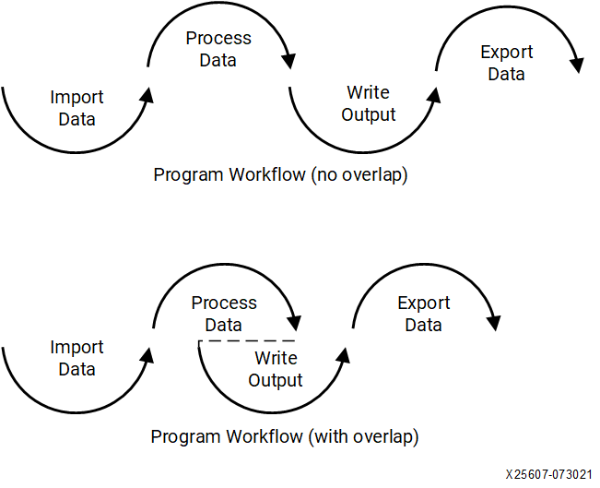
Producer-Consumer Paradigm

Slide 30
Data Streaming for Producer-Consumer
Enabled by FIFO (first-in first-out) buffers
The consumer process can start accessing the data inside the FIFO buffer as soon as the producer inserts the data into the buffer
If the buffer is full/empty, automatically stalls
array_A
array_B
function_1
function_2
function_3
FIFO
FIFO
function_1
function_2
function_3

Slide 31
Data Streaming for Producer-Consumer
Enabled by FIFO (first-in first-out) buffers
The consumer process can start accessing the data inside the FIFO buffer as soon as the producer inserts the data into the buffer
If the buffer is full/empty, automatically stalls
To be more general, this is called Task Level Parallelism (TLP)
FIFO
FIFO
function_1
function_2
function_3

Slide 32
Outline
Burst mode
Wide bus transaction
Double Buffer
Streaming
C/RTL Co-simulation

Slide 33
Resource Utilization
Resource utilization (DSP, LUT, BRAM) and latency value
These are only estimation by Vitis HLS – not reliable!
I’m surprised by how inaccurate the estimation could be… (they used to be fine at least for DSPs…)
What to do?!
C/RTL co-simulation or LightningSim – to get actual cycle counts
Apply implementation – really map those generated RTL onto FPGA

Slide 34
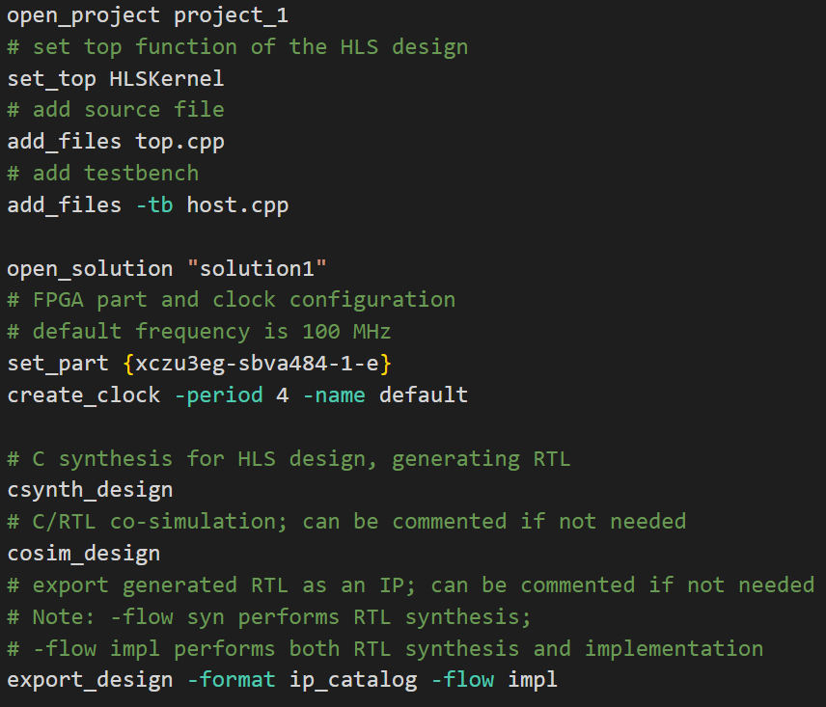


Vitis HLS Flow – Recap
// Host code
// A.k.a., testbench
// HLS design
C Simulation (C-sim)
C Synthesis (C-syn)
RTL (Verilog)
C/RTL Co-simulation (Co-sim)
RTL Synthesis
Placement and Routing
bitstream
program
FPGA

Slide 35
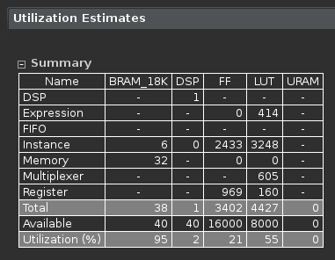
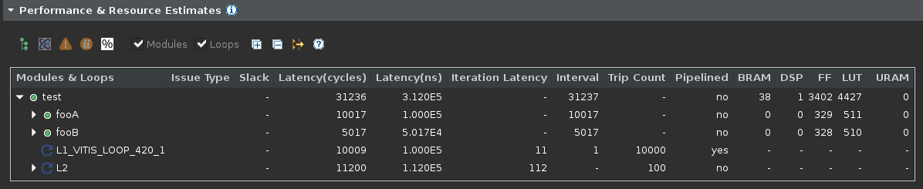
Synthesis v.s. Implementation
This is what you get from Synthesis report
Performance and Resource Estimation

Slide 36
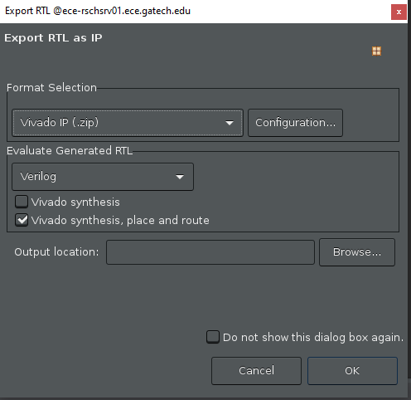
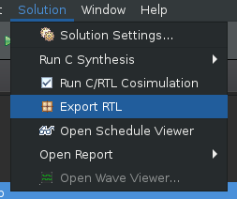

Synthesis v.s. Implementation
Run Implementation in GUI

Slide 37
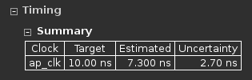
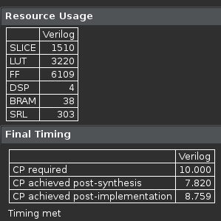
Synthesis v.s. Implementation
Implementation
Synthesis

Slide 38
Summary
Widening the memory port – fully utilize DRAM bandwidth
Double buffer to hide the data loading latency
More advanced (challenging) technique: streaming and dataflow
More generally, Task Level Parallelism (TLP)

